Slide 1
Top 10 losing horses
In Derby history

Slide 2
Alsab
Ran second in 1942 Derby
Won 15 races at age two
Beat Triple Crown Winner Whirlaway two out of three times
Final record – 25 wins in 51 starts

Slide 3
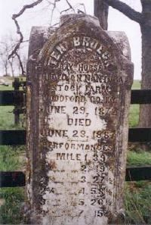
Ten Broeck
Ran fifth in 1875 Kentucky Derby
Set world record in a four mile heat
Most famous for beating California mare Mollie McCarthy in match race, July 4, 1878
First horse honored with a headstone at burial
Final Record - 23 wins in 30 starts

Slide 4
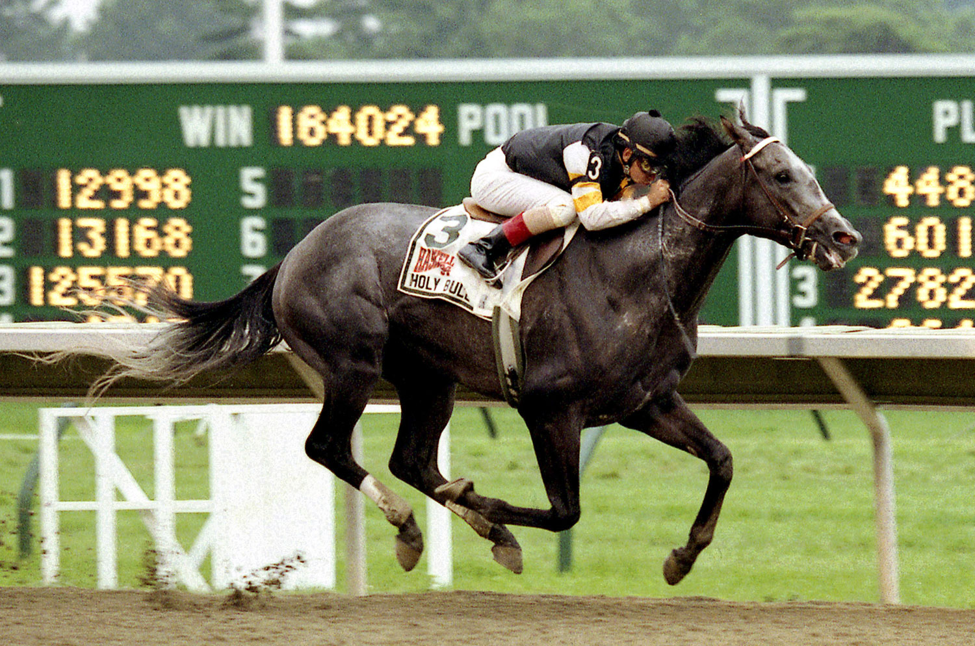
Holy Bull
Ran 12th in 1994 Kentucky Derby
Did not run in Preakness, Belmont or Breeders Cup - but won four Grade One races to earn Horse of the Year honors
Suffered career ending injury in second race as a four year old
Won 13 of 16 starts

Slide 5
Easy Goer
Ran second in 1989 Kentucky Derby
In 20 starts, only five horses ever finished in front of him
Ran the fastest mile for a three year old on dirt in world history in Gotham Stakes
Won 14 races in 20 starts

Slide 6
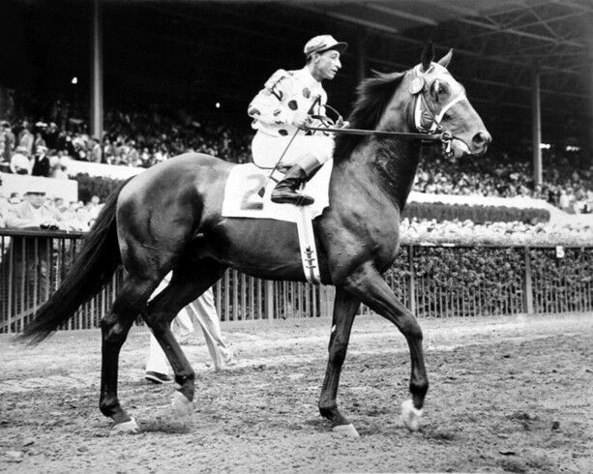
Nashua
Ran second in 1955 Kentucky Derby
Beat Derby winner Swaps in match race
Retired as the all-time leading money earner
Won 22 races in 30 starts

Slide 7
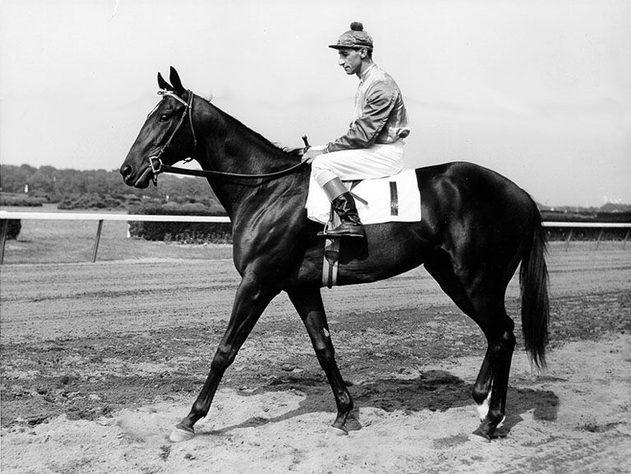
Bold Ruler
Ran fourth in 1957 Kentucky Derby
Named champion three year old of 1957 over many notables
Champion sprinter
Won 23 races in 33 starts

Slide 8
Damascus
Ran third in 1967 Kentucky Derby
Won Preakness, Belmont, Travers, JC Gold Cup, Dwyer, Woodward
Beat Dr. Fager and Buckpasser by 10 lengths
Won 21 races in 32 starts

Slide 9
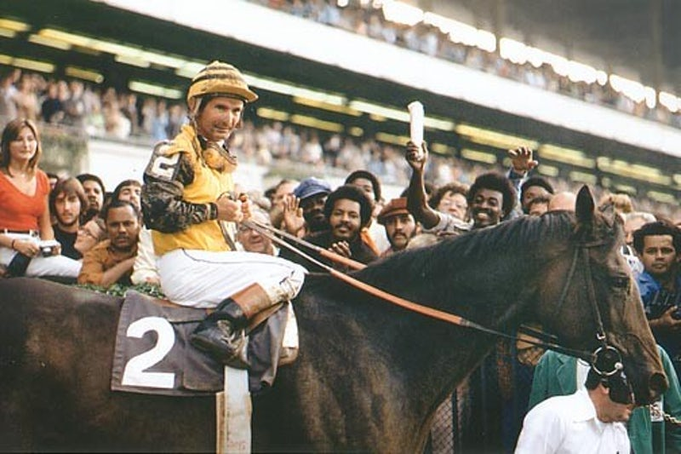
Forego
Ran fourth in 1973 Kentucky Derby
A gelding, he raced until 8 years of age and won 14 Grade 1 races
Named American Horse of the Year three consecutive years
Won 34 of 57 starts

Slide 10
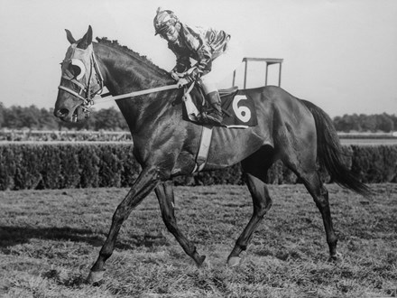
Round Table
Ran third in 1957 Kentucky Derby
Equally effective on dirt and turf
Set, or equaled 14 track records and set one world record
Won 43 races in 66 starts

Slide 11
Native Dancer
Ran second in 1953 Kentucky Derby
Won Preakness, Belmont and Travers
“Nicknamed “The Gray Ghost”, considered racing’s first television star
Won 21 races in 22 starts – only loss was the Kentucky Derby

